Slide 1
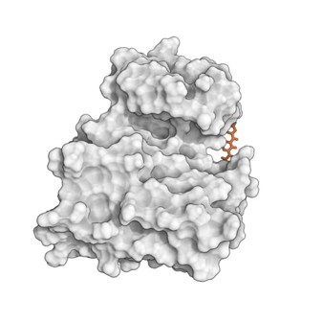
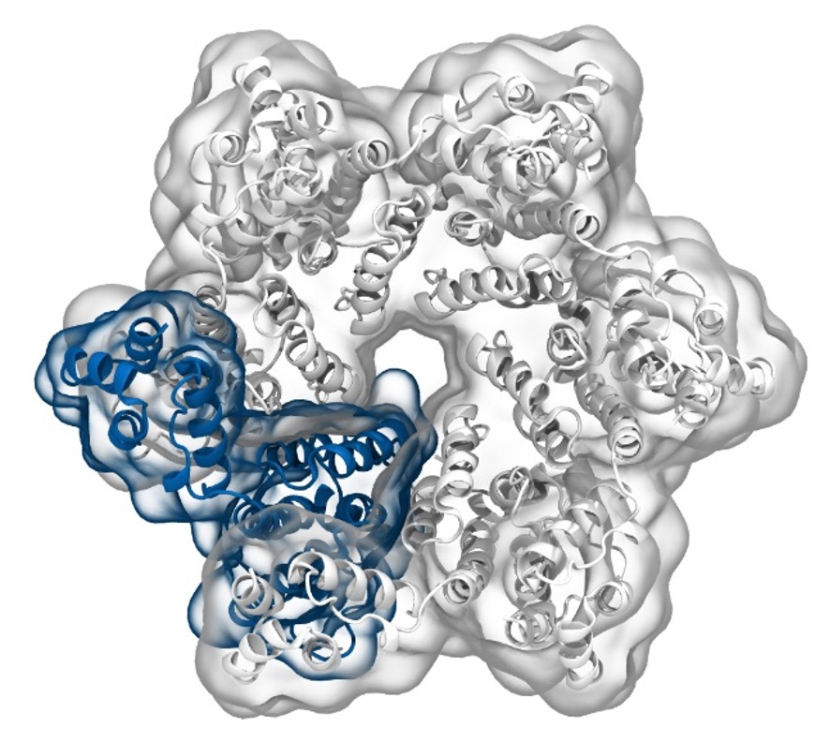
Simulation of Biomolecules
Clustering
2024 CCP5 Summer School
Dr Matteo Degiacomi
Durham University
matteo.t.degiacomi@durham.ac.uk
Dr Antonia Mey
University of Edinburgh
antonia.mey@ed.ac.uk

Slide 2

The Data Mining world
From scikit-learn.org
2

Slide 3
The Data Mining world
From scikit-learn.org
3

Slide 4
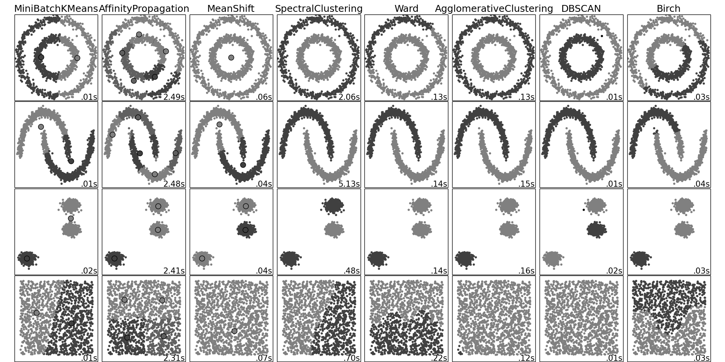
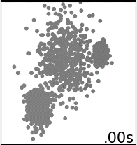
Clustering (i.e., unsupervised learning)
Known number of clusters? Flat geometry?
Even cluster size? Outliers? Centroids needed?
4

Slide 5
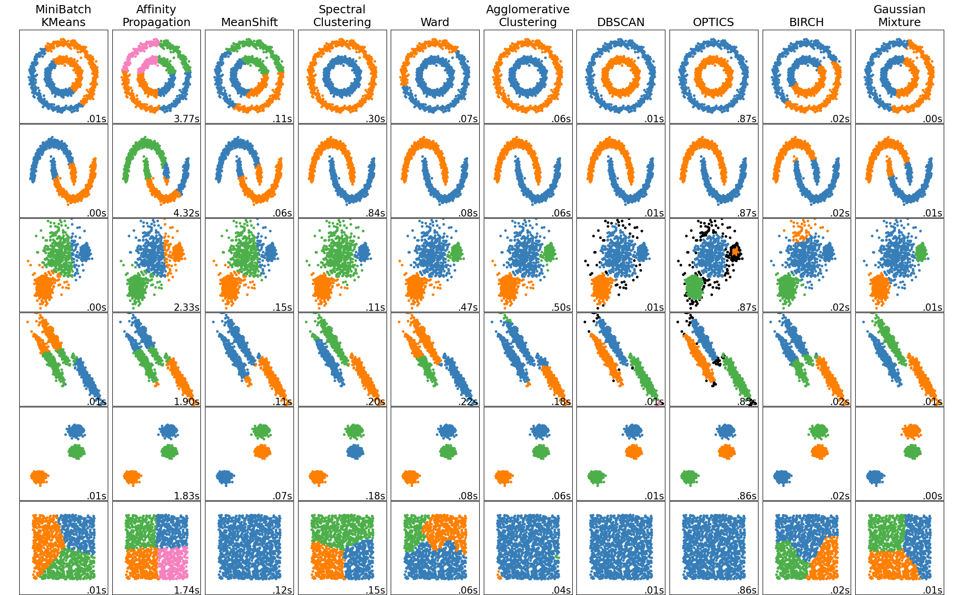
Clustering algorithms
scikit-learn.org/stable/modules/clustering.html
5

Slide 6
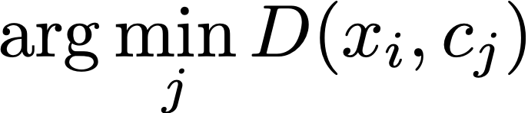
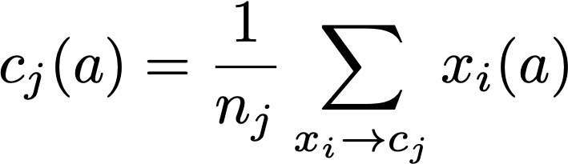
How does k-means work?
Input: K, set of points x1…xn (can be in N-dimensional)
Place centroids, c1…,cn at random locations
Repeat until convergence:
For each point xi:
Find nearest centroid cj =
Assign the point xi to cluster j
For each cluster j = 1…K:
Compute the centroid mean for all points in
one cluster and update the centroid
6

Slide 7

How does k-means work?
Input: K, set of points x1…xn (can be in N-dimensional)
Place centroids, c1…,cn at random locations
Repeat until convergence:
For each point xi:
Find nearest centroid cj =
Assign the point xi to cluster j
For each cluster j = 1…K:
Compute the centroid mean for all points in
one cluster and update the centroid
7

Slide 8
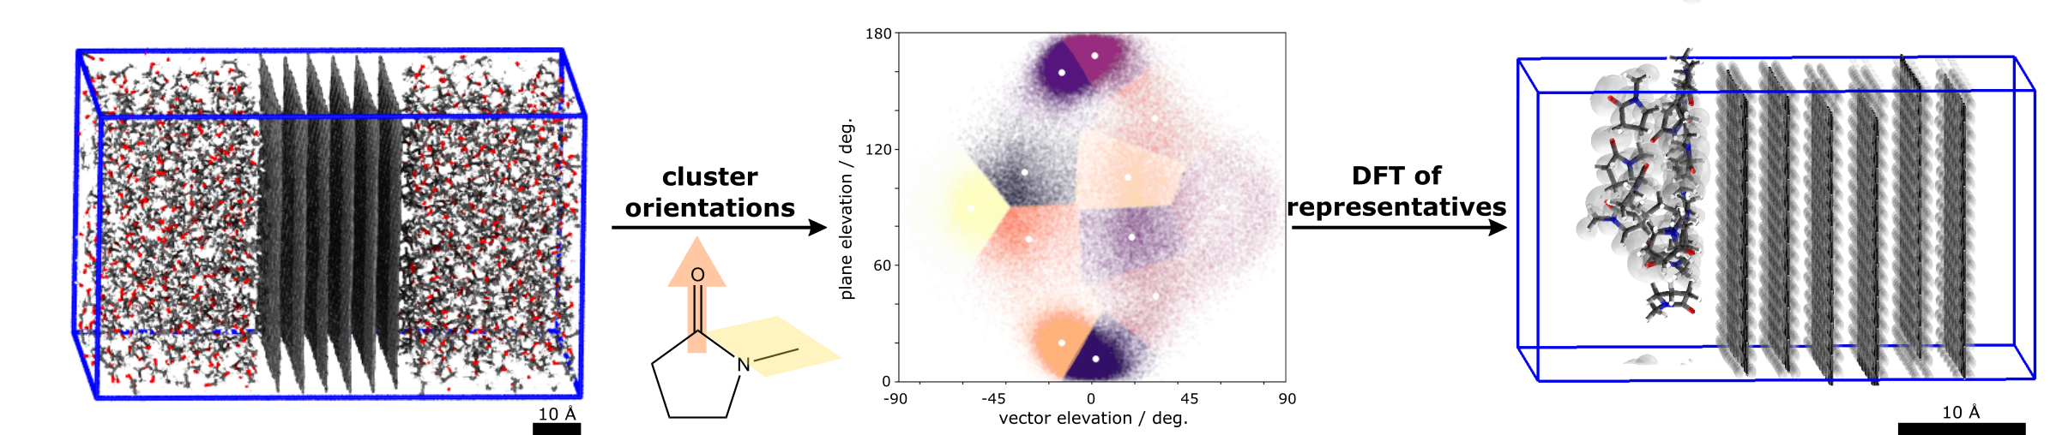
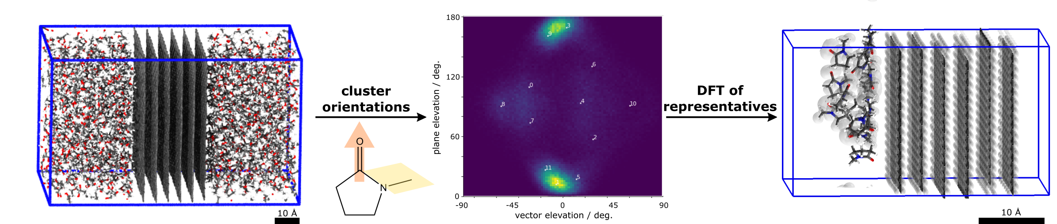
[Example] k-means vs solvent-graphite interactions
Molecular Dynamics simulation of graphite immersed in solvents.
>100k individual solvent-graphene interactions
8
S. J. Goldie, M. T. Degiacomi, et al. Identification of Graphene Dispersion Agents through Molecular Fingerprints. ACS Nano, 2022

Slide 9
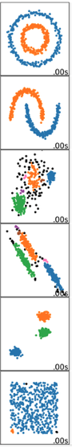
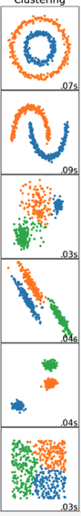
Density-based and spectral clustering
DBSCAN
Spectral Clustering
9

Slide 10
Density-based and spectral clustering
Spectral
Clustering
DBSCAN
Find the points in the ε neighbourhood of every point, identify core points with more than n neighbours.
Find the connected components of core points on the neighbour graph, ignoring all non-core points.
Assign each non-core point to a nearby cluster if the cluster is an ε neighbour, otherwise assign to noise otherwise.
Calculate the Laplacian
Calculate the first k eigenvectors
Consider the matrix formed by the first k-eigenvectors
Cluster the graph nodes based on these features (e.g. k-means)
10

Slide 11
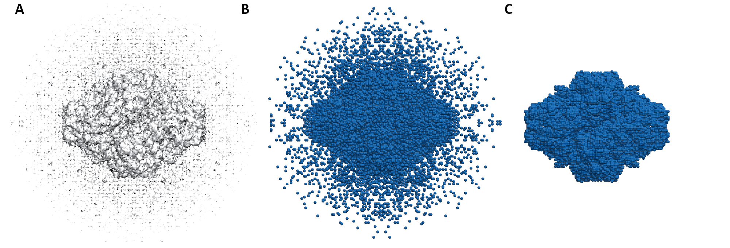
[Example] DBSCAN for noise detection in EM maps
Load electron density map and chose a threshold t
Place pseudoatoms where intensity > t
Cluster beads and delete small clusters (<1% of total beads)
M.T.Degiacomi and J.L.P. Benesch, EM∩IM: software for relating ion mobility mass spectrometry and electron microscopy data, Analyst, 2015
11

Slide 12



Post-its
Something you think could be improved
Something you liked
Something you liked
😎👍
😬👎

